Slide 1
Introduction to Ethereum

Slide 2
What is Ethereum
2nd generation PoW blockchain
Support smart-contracts
Accounts based architecture

Slide 3
Ethereum Nodes
An Ethereum node is the application that implements Ethereum Protocol
It possibly connects to other nodes
It gives you access to the blockchain
Can do mining or some other stuff

Slide 4
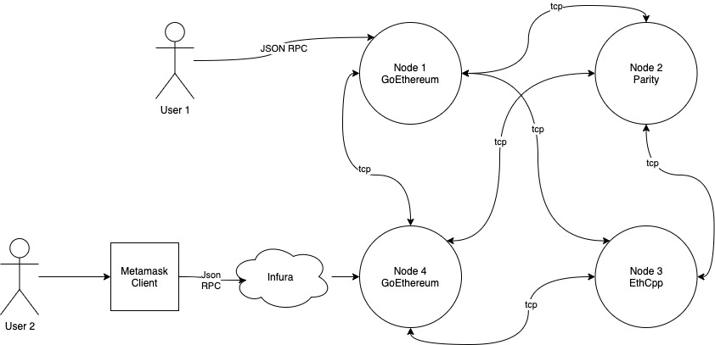
Nodes topology
Protocol implementations:
Go: GoEthereum
Java: JavaEthereum
Cpp
Python
Parity: Rust
Full Ethereum database around 500 GBs

Slide 5
Simulation of protocol
Ethereum Test Networks:
Rinkeby, Ropsten, Kovan, Goerli
For final testing of smart-contracts, integration and DApps testing
Ethereum test-rpc (ganache)
For unit-testing smart-contracts
Can save lots of time
Can work differently then test networks

Slide 6
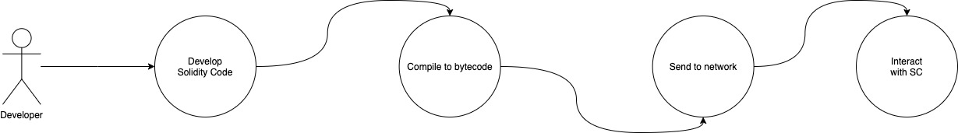
Deployment process

Slide 7
Smart-contracts
Introduced by Nick Szabo in 1994
A piece of code running on the blockchain
It’s a state machine
Need transactions to change state
Can do logic operations
State change happens through mining through transactions
Turing complete

Slide 8
Smart-contract programming languages
Serpent (python like) - deprecated
Solidity (es like) – current, stable
LLL – low level, lisp-like
Yul – work in progress, intermediate language
Viper – research-oriented, derived from python
Mutan – deprecated Go-based language

Slide 9
Solidity
The most populare language
It’s compared to JS (but better ECMA Script)
Compiles to bytecode (Ethereum Virtual Machine Assembly Code)
Every ethereum node in the network executes the same code

Slide 10
Solidity
“Class” like Structure
Multi-inheritance
Contains functions
Control structures: IF/ELSE
Loops: FOR/WHILE
DataTypes:
(U)Int, Boolean, Array
Struct, Mapping, Address
No Floats!
Special structures like: modifiers, payable
Imports

Slide 11
Tools to develop contracts
Ganache or TestNets – for fast and 0-cost mining
Remix-IDE – IDE to develop smart-contracts
Truffle Suite – tools to test and deploy contracts
OpenZeppelin – library of audited smart-contracts
Zeppelin OS – framework for fast deployment and upgrade of SCs

Slide 12
ByteCode
Similar to Assembler
Runs on the EVM
Each OpCode consumes GAS
Each block has gas limit
Users can set gas limit for each transaction
Failed transaction can consume all gas limit
Max Size = 24KB

Slide 13
Smart-contract address computation
The address for an Ethereum contract is deterministically computed from the address of its creator (sender) and how many transactions the creator has sent (nonce). The sender and nonce are RLP encoded and then hashed with Keccak-256.

Slide 14
Interaction
Low Level, through the “data” field when sending transaction
The Keccak-256 SHA3 of the given function name including parameters
Function `thisFunction(uint variable, uint otherVariable) { … } Results in data = sha3(`thisFunction(uint,uint)`)
We will not do this, there are better ways
Client use an ABI = Application Binary Interface
Contains all the Functions/Parameters/Return values and Events
Used to interact
Not stored on the blockchain or nodes

Slide 15
Changing the smart-contract
Smart-contracts are immutable but upgradable
Changes could be not possible
Be careful when programming them
TEST!

Slide 16
Practice!
Setup wallet https://metamask.io/
Use Ganache and Truffle
Develop first small smart-contract (ERC-20 Token)
Deploy to test-net (https://faucet.rinkeby.io/)
Code: https://github.com/4IRE-Labs/academy-practice/tree/master/lecture2/4ireCoin

Slide 17
Home-Work
Deploy Burnable ERC-20 Token to Ropsten TestNet
https://www.udemy.com/course/ethereum-masterclass/

